Slide 1
AC-Coupled Communication Encoding for Zero DC Offset
Neuralink, US 11582072, 2/24/2023
4/11/2024

Slide 2
Purpose of Patent
Problem: Electrical signals near neural tissue is risky, due to current leaking from electrical cables
Solution: DC level of implanted cables must be as close to 0 as possible (close to ground potential of device)

Slide 3
Outline
Goal: Describe a 3-level encoding transmitter where a transmitter circuit is configured to receive an input data signal including binary data and transmit encoded data signal
Embodiments:
Block diagram of 3-level encoding transmitter
Transmission control circuit
Inverter circuit
Idle circuit
Transmitter circuit (transmission control + inverter + idle altogether)
Active vs Idle state
3-level encoding receiver circuit

Slide 4
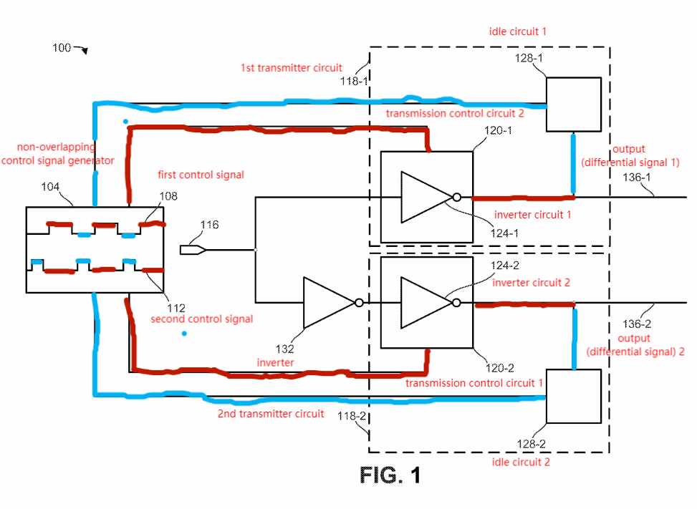
Block diagram of 3-level encoding transmitter
3-level:
Receive input data signal
Encode data signal
Transmit differential data signal as output
Non-overlapping control:
1st control active (2nd control inactive) - generate encoded output signal by transmission control circuits + inverter circuits
2nd control active (1st control inactive) - idle circuits activated

Slide 5
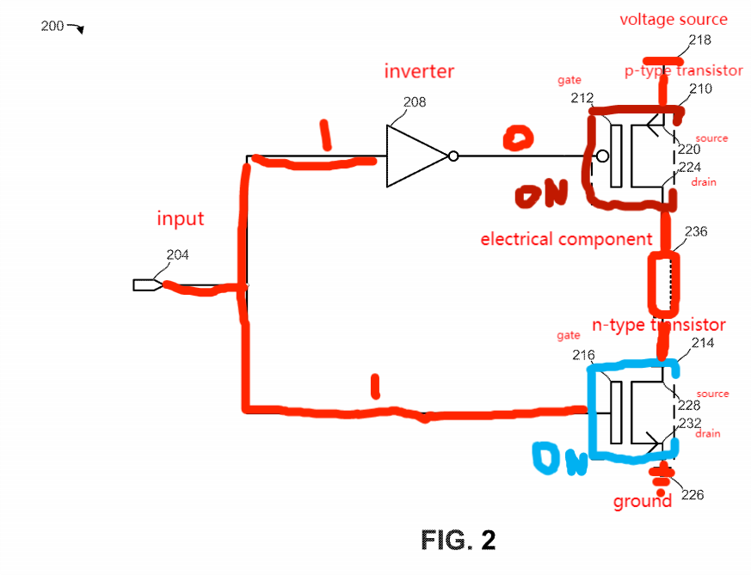
Transmission control circuit
Control 1 or more electrical components based on control signal
p-type transistor
connected to voltage source
ON when gate receive voltage below threshold - electricity flows from voltage source from source to drain
n-type transistor
connected to ground
ON when gate receive voltage above threshold - electricity flows from voltage source from source to drain
p-type & n-type ON - connected to voltage and ground - activate electrical components
p-type & n-type OFF- disconnected to voltage and ground - deactivate electrical components

Slide 6
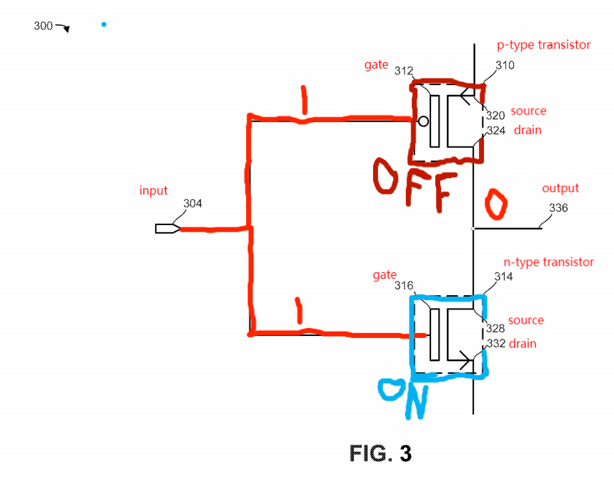
Inverter circuit
Negates input signal
Only 1 of p-type or n-type can be on
Input = 1: p-type off, n-type on --> Output = 0
Input = 0: p-type on, n-type off --> Output = 1

Slide 7
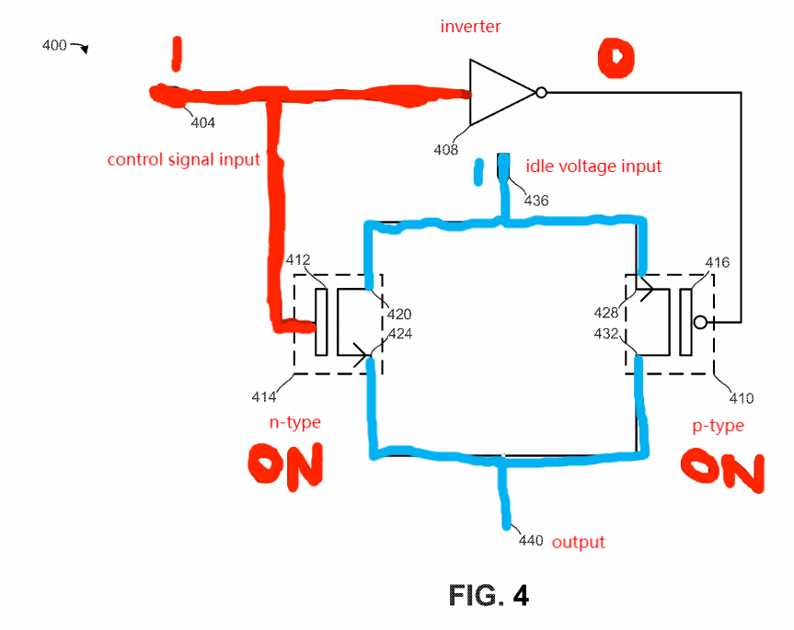
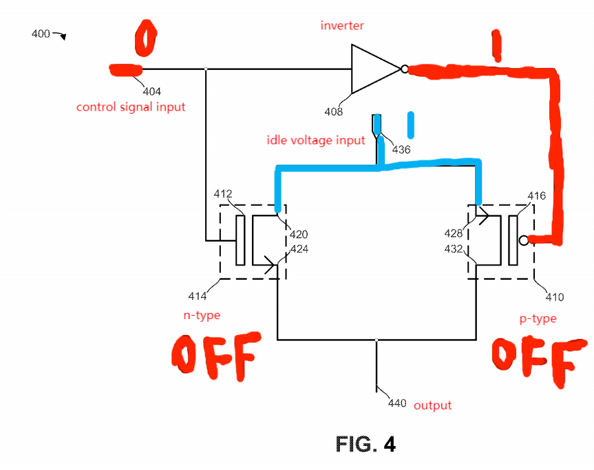
Idle circuit
Control signal input = 1
--> Both p-type & n-type ON
--> idle voltage flows to output
Control signal input = 0
--> Both p-type & n-type OFF
--> idle voltage DOES NOT flow to output

Slide 8
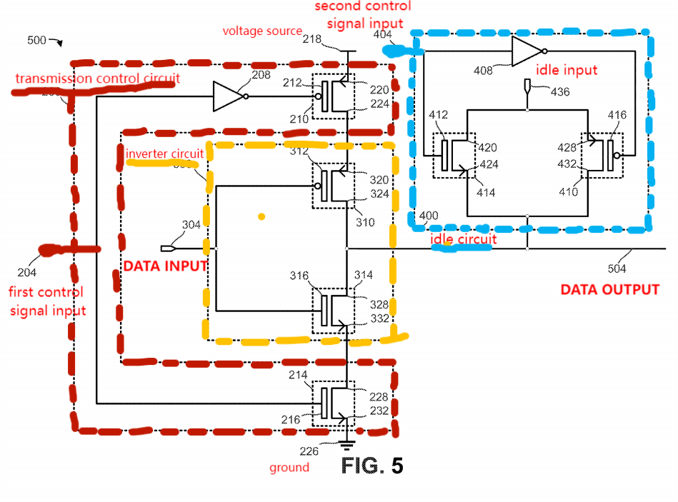
Transmitter circuit -- PUT ‘EM ALL TOGETHER!
Put transmission control + inverter + idle circuit all together
First & second control inputs -- non-overlapping
Data output - Can be coupled with receiver circuit to receive & decode encoded data signal from data output
Transmitter circuit can be coupled with other transmitter circuits

Slide 9
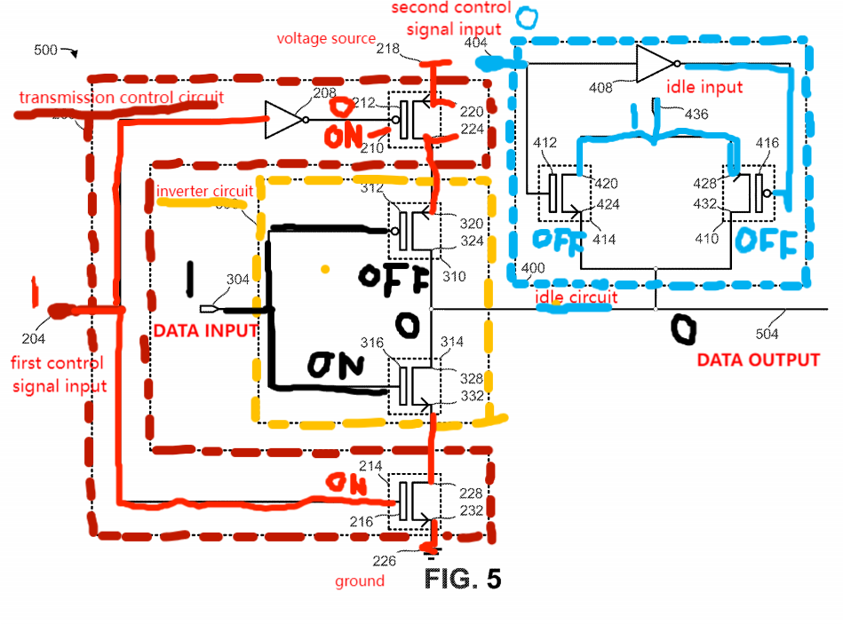
Transmitter Circuit: Active State
1st control signal = 1 (active)
2nd control signal = 0 (not idle)
--> both transistors of transmission control circuit on
--> activate the transmission control circuit
--> data output = inverse of data input

Slide 10
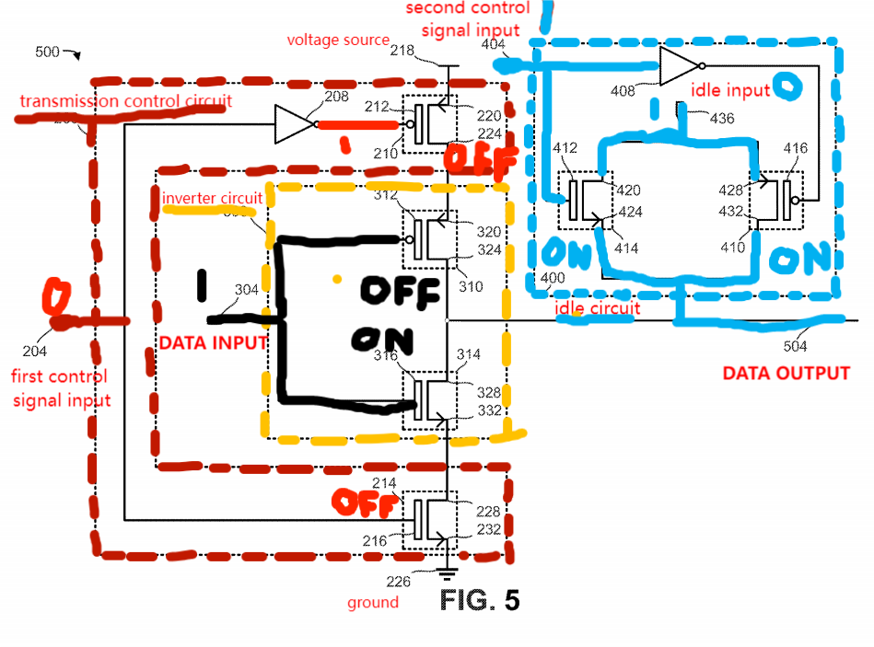
Transmitter Circuit: Idle State
1st control signal = 0 (not active)
2nd control signal = 1 (idle)
--> both transistors of transmission control circuit off
--> not connected to voltage source and ground
--> CANNOT send data input through the inverter to the output
--> data output = idle voltage input

Slide 11
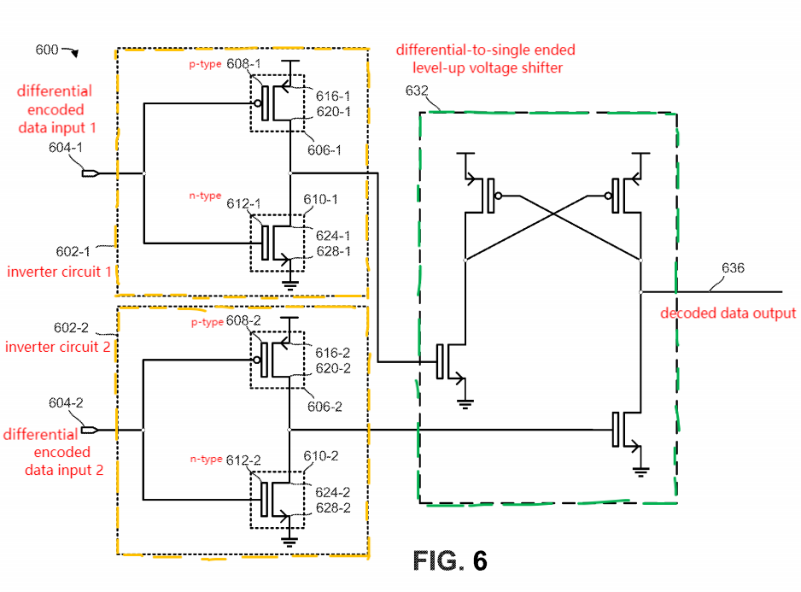
3-level encoding receiver
2 encoded data inputs + 1 decoded data output
Encoded data inputs - receive 3-level encoded differential signal
Decoded data output - transmit single-ended signal including binary data received by encoded data inputs
2 inverter circuits + 1 differential-to-single ended level up voltage shifter
Inverter circuits to negate input signals
Differential-to-single ended level up voltage shifter: generate single-ended output signal with sufficient amplitude to drive logic circuits (when differential input signals cannot drive circuits)
3rd voltage signal: used to reduce/eliminate power consumption by 3-level encoding receiver when there is no data to receive
Some embodiments - Size difference between p & n-type transistors --> reduce power consumed by inverter circuits when encoded data signal at inputs is at 3rd voltage level (USUALLY FOR ANALOG SIGNALS)

Slide 12
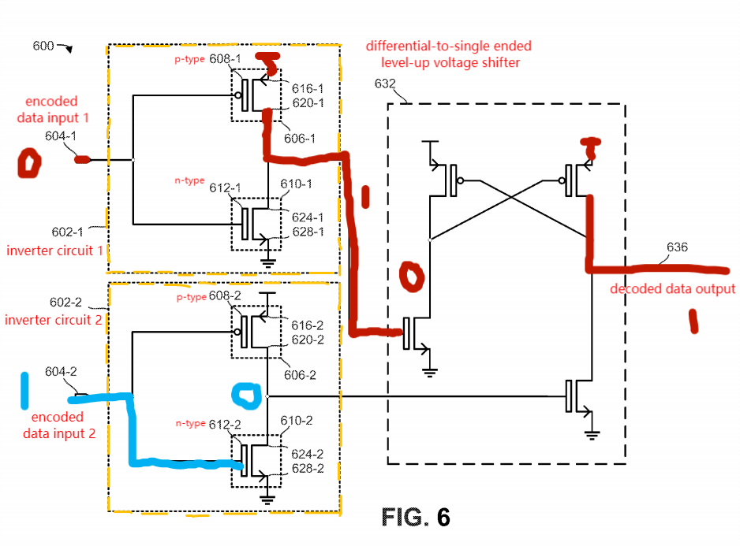
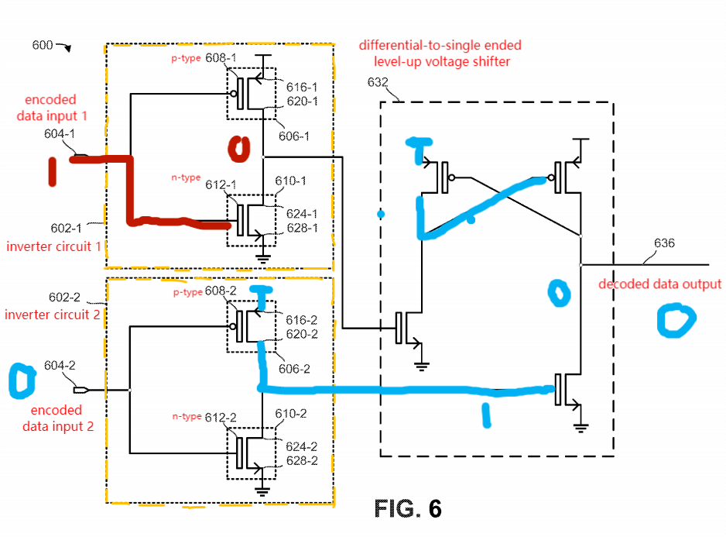
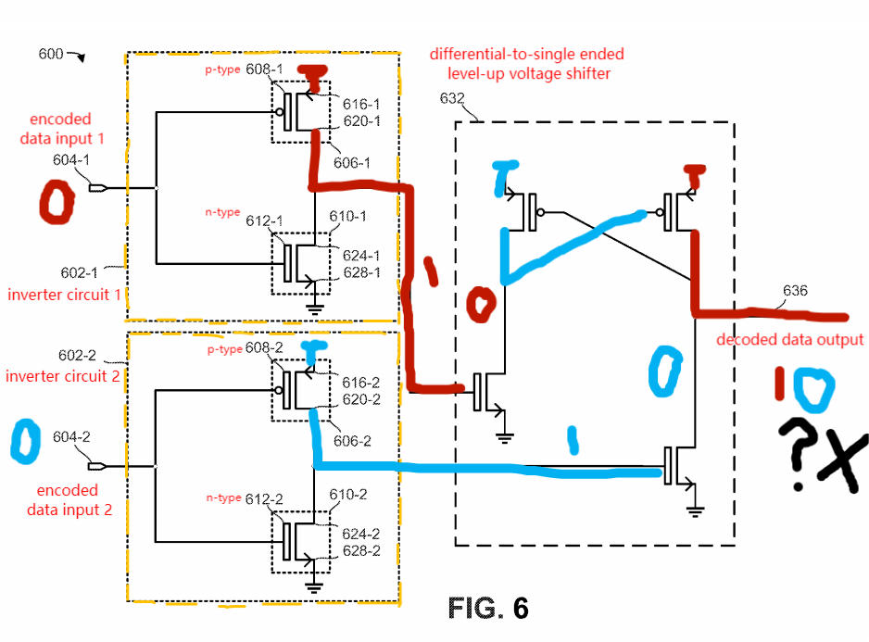
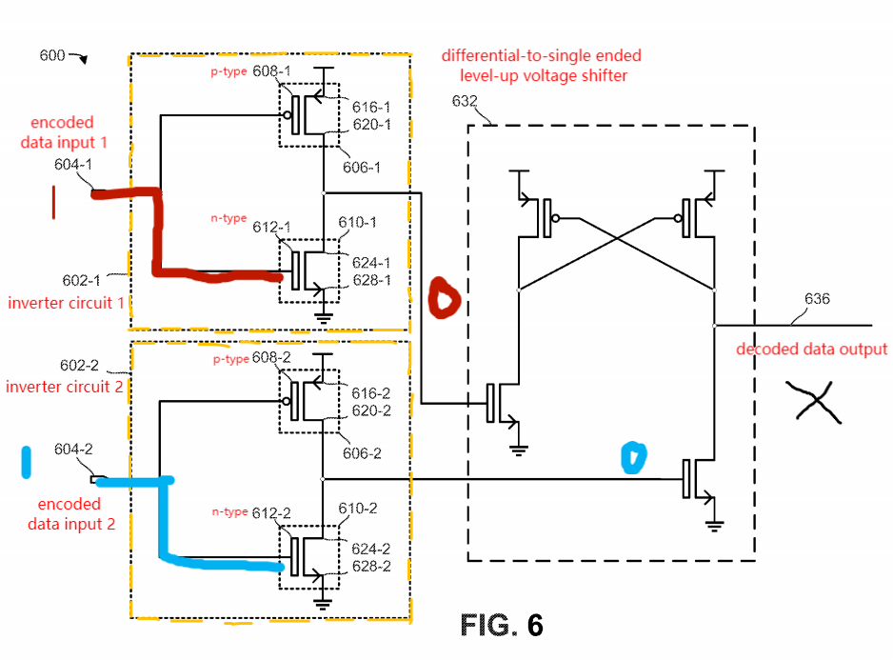

3-level encoding receiver (cont.)
Decoded output receives signal when XOR = 1 (01 or 10), does NOT receive signal when XOR = 0 (11 or 00)
Encoded data inputs = 01
--> Decoded output = 1
Encoded data inputs = 10
--> Decoded output = 0
Encoded data inputs = 11
--> Decoded output does NOT receive
Encoded data inputs = 00
--> LATCH (BURNED CIRCUIT!)
Note: Embodiment circuit is just an example!
Q: How to connect the decoded data output from transmitter circuit to receiver?

